Slide 1
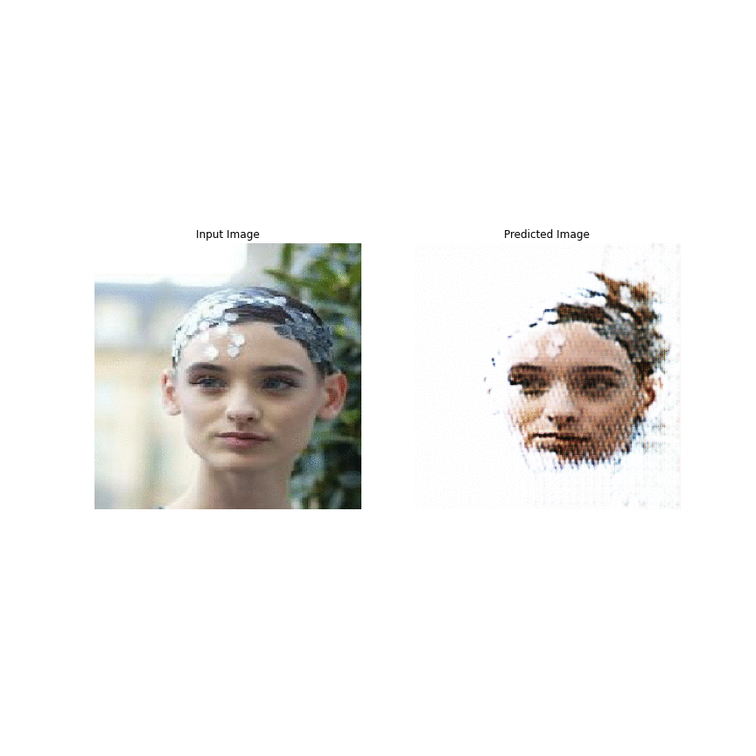
Artificial Neural Network and Deep Learning Project: GAN – Creating cartoon faces from celebrity faces Date: 26.05.2020
Anna Wrobel
Memeti Nurdzane
Notes:
Instructions: • Explain the task to be solved.
In this presentation, we are interested in generating a cartoon face of celebrities by using unpaired training data between real faces and cartoon ones. A major challenge of this task is that the structures of real and cartoon faces are in two different domains, whose appearance differs greatly from each other. Without explicit correspondence, it is difficult to generate a high quality cartoon face that captures the essential facial features of a person.

Slide 2
Content
Part 1: Unpaired Image – to – image Translation
Part 2: Application of GAN
Part 3: Visualization
Part 4: Problems encountered
Part 5: Further Development
Notes:
In our presentation we will go in these following parts

Slide 3
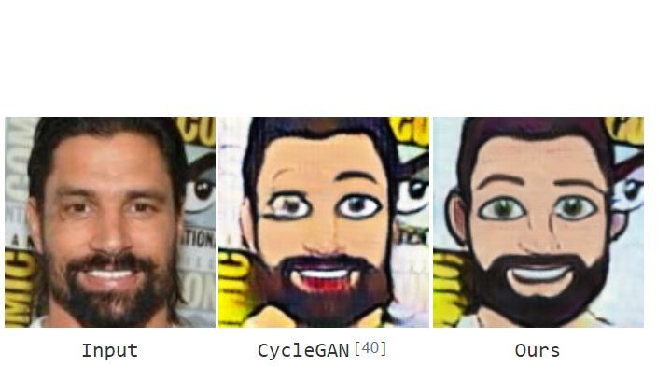
Part 1: Unpaired Image – to – image Translation
Motivation
generate new images -> Anime
Image-to-Image Translation
Training is conditioned on the images from the source domain.
Exploring one of the most powerful and complex GAN architectures: CycleGAN
1000 images for training and 100 images for test
Figure 1: Figure 1: Given a real-face image, our goal is to generate its corresponding cartoon face, which preserves necessary attributes. Source: https://www.groundai.com/project/landmark-assisted-cyclegan-for-cartoon-face-generation/1

Slide 4
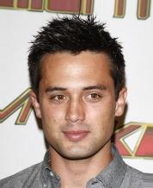
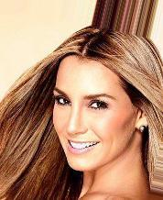




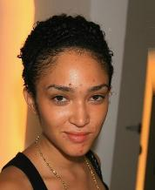
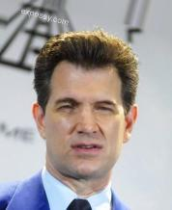
Part 1: Unpaired Image – to – image Translation Datasets
Aligned Celeba
Cartoons10k
Notes:
They are 2 available datasets for cartoons as in the lecture of martin. First we wanted to take anime datasets but they were no anime dataset available.
https://www.groundai.com/project/landmark-assisted-cyclegan-for-cartoon-face-generation/1

Slide 5
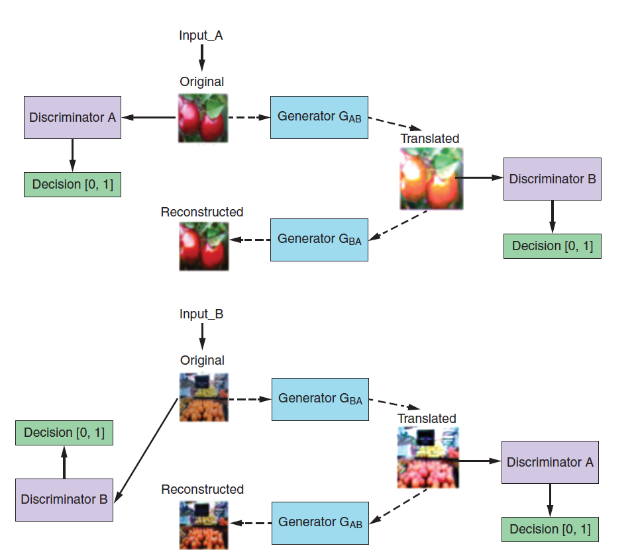
Part 2: Application of GAN CycleGAN
CycleGAN
GeneratorAB - translating from image A to image B, called G_AB,
Generator BA - translating back from B to A, called G_BA.
Discriminator A
Discriminator B
Figure 2:In this simplified architecture of the CycleGAN, we start with the input image, which either (1) goes to the Discriminator for evaluation or (2) is translated to one domain, evaluated by the other Discriminator, and then translated back. (Source: “Understanding and Implementing CycleGAN in TensorFlow,” by Hardik Bansal and Archit Rathore, 2017, https://hardikbansal.github.io/CycleGANBlog/.)

Slide 6
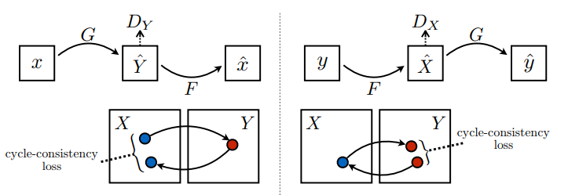
Part 2: Application of GAN Three types of loss functions
Adversarial loss: How well the produced images fool the discriminator?
Cycle-consistency loss: Do we return to original image if we apply two generators one after other (both direction)?
Identity loss: Do we return to the original image if we apply generator from its own domain on it?

Slide 7
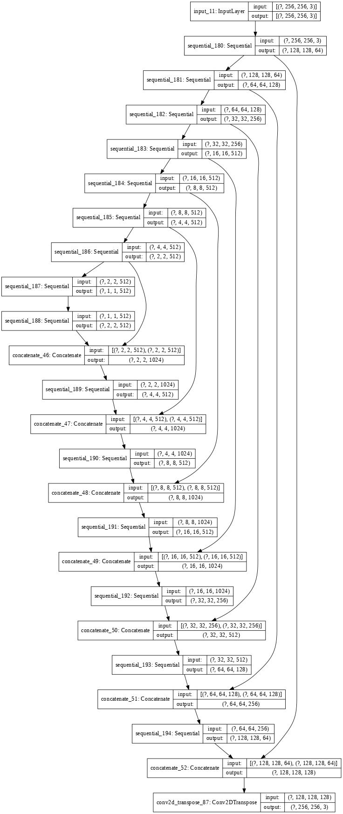
Part 2: Application of GAN - modified U-Net Generator
Each block in the encoder is:
Conv -> Instance norm -> Leaky ReLU
Each block in the decoder is:
Transposed Conv -> Instance norm -> Dropout (applied to the first 3 blocks) -> ReLU
There are skip connections between the encoder and decoder
Notes:
Instructions:
• Analyse your data. Visualize and explain the data features you deem to be relevant for the project.
• Explain your approach. That is, explain your model, the model architecture, optimizers, regularization, etc. used.
• Experiment with your model: change it, tune hyperparameters, etc. Do not copy paste a model without substantially adopting it to your problem/task. Explain your final model.
SOURCE: https://www.tensorflow.org/datasets/catalog/cycle_gan

Slide 8
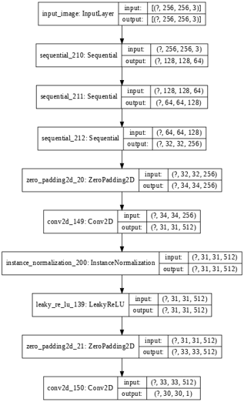
Part 2: Application of GAN – PatchGAN Discriminator
Each block in the discriminator is
Conv -> Instance Norm -> Leaky ReLU
The shape of the output after the last layer is (1, 30, 30, 1)
Each 30x30 patch of the output classifies a 70x70 portion of the input image

Slide 9
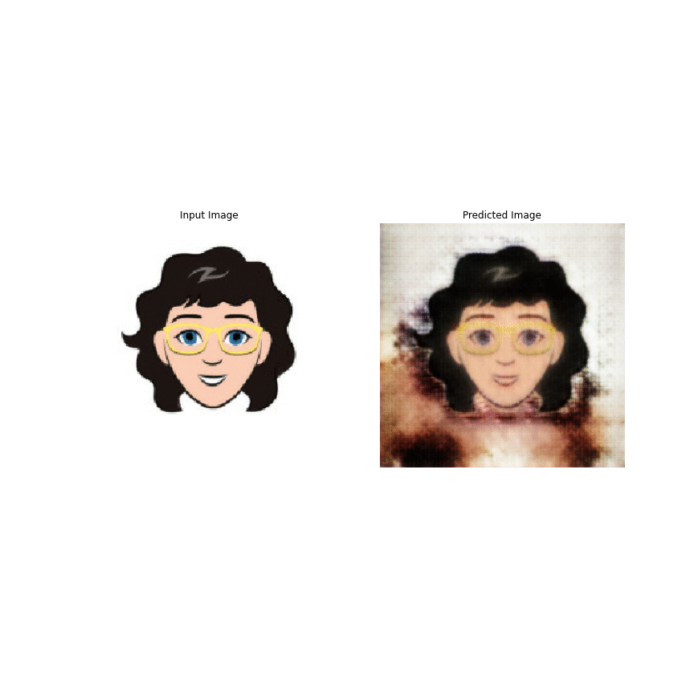
Part 3: Visualization – Training
Cartoon - Image
Image - Cartoon
Notes:
Instructions:
• Show/explain/visualize your results..

Slide 10
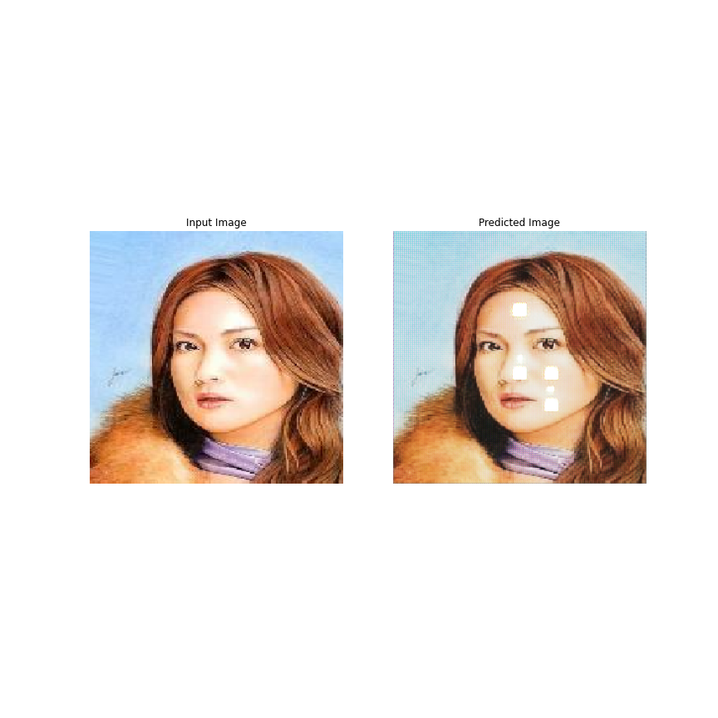
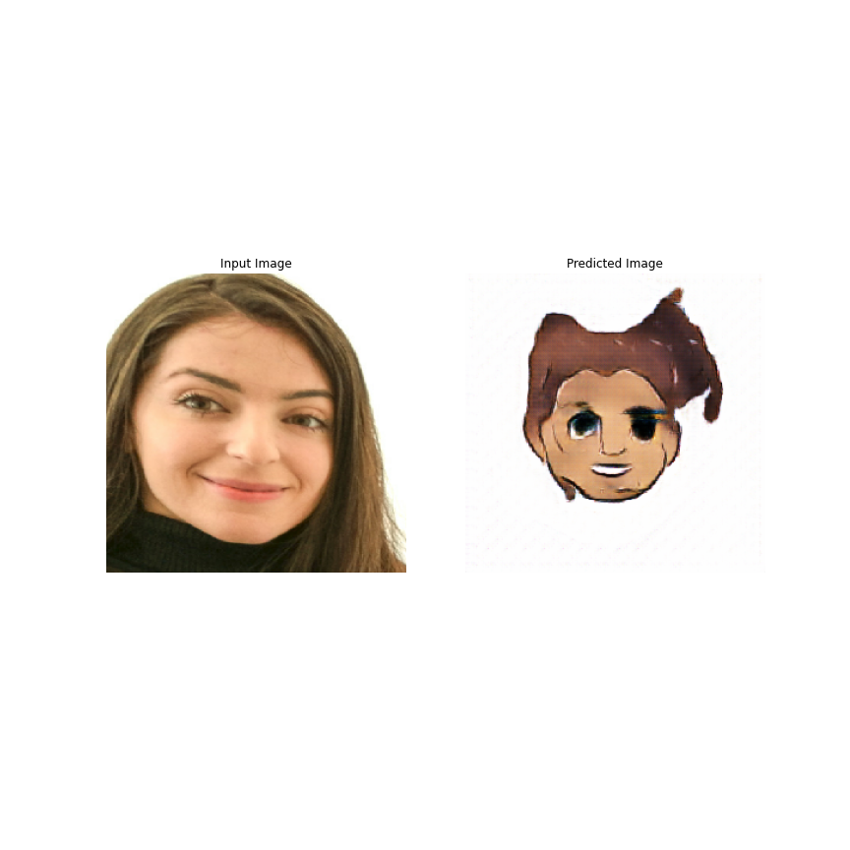
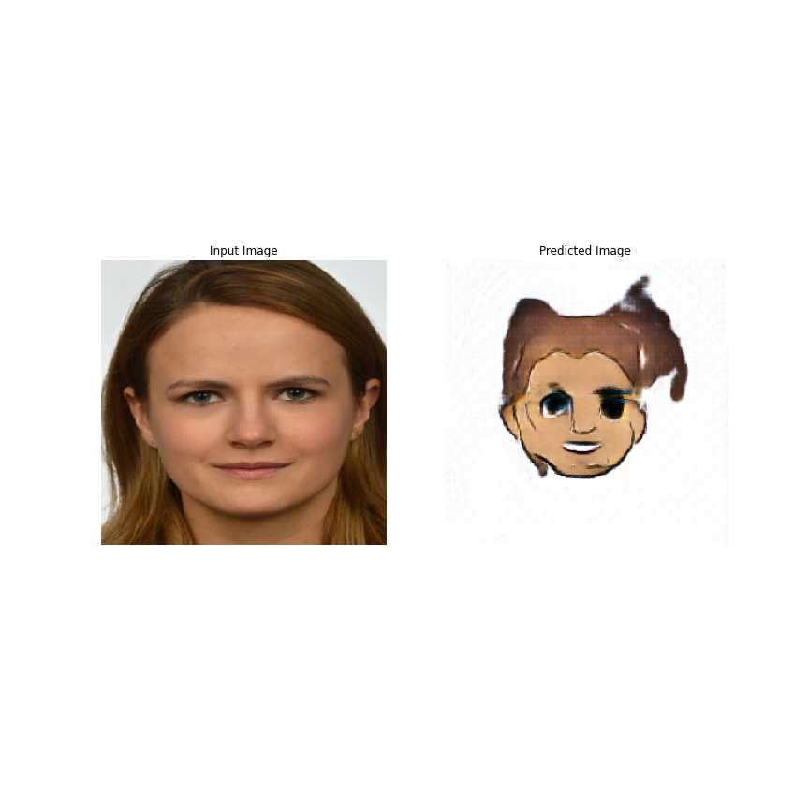
Part 4: Problems encountered "GANs are difficult to train."
Mode collapse
No convergence for generator
Slow to train
The simultaneous training of generator and discriminator models in GANs is inherently unstable.
Stable training of GANs remains an open problem
Computationally expensive
No success with WGAN parameter tuning

Slide 11
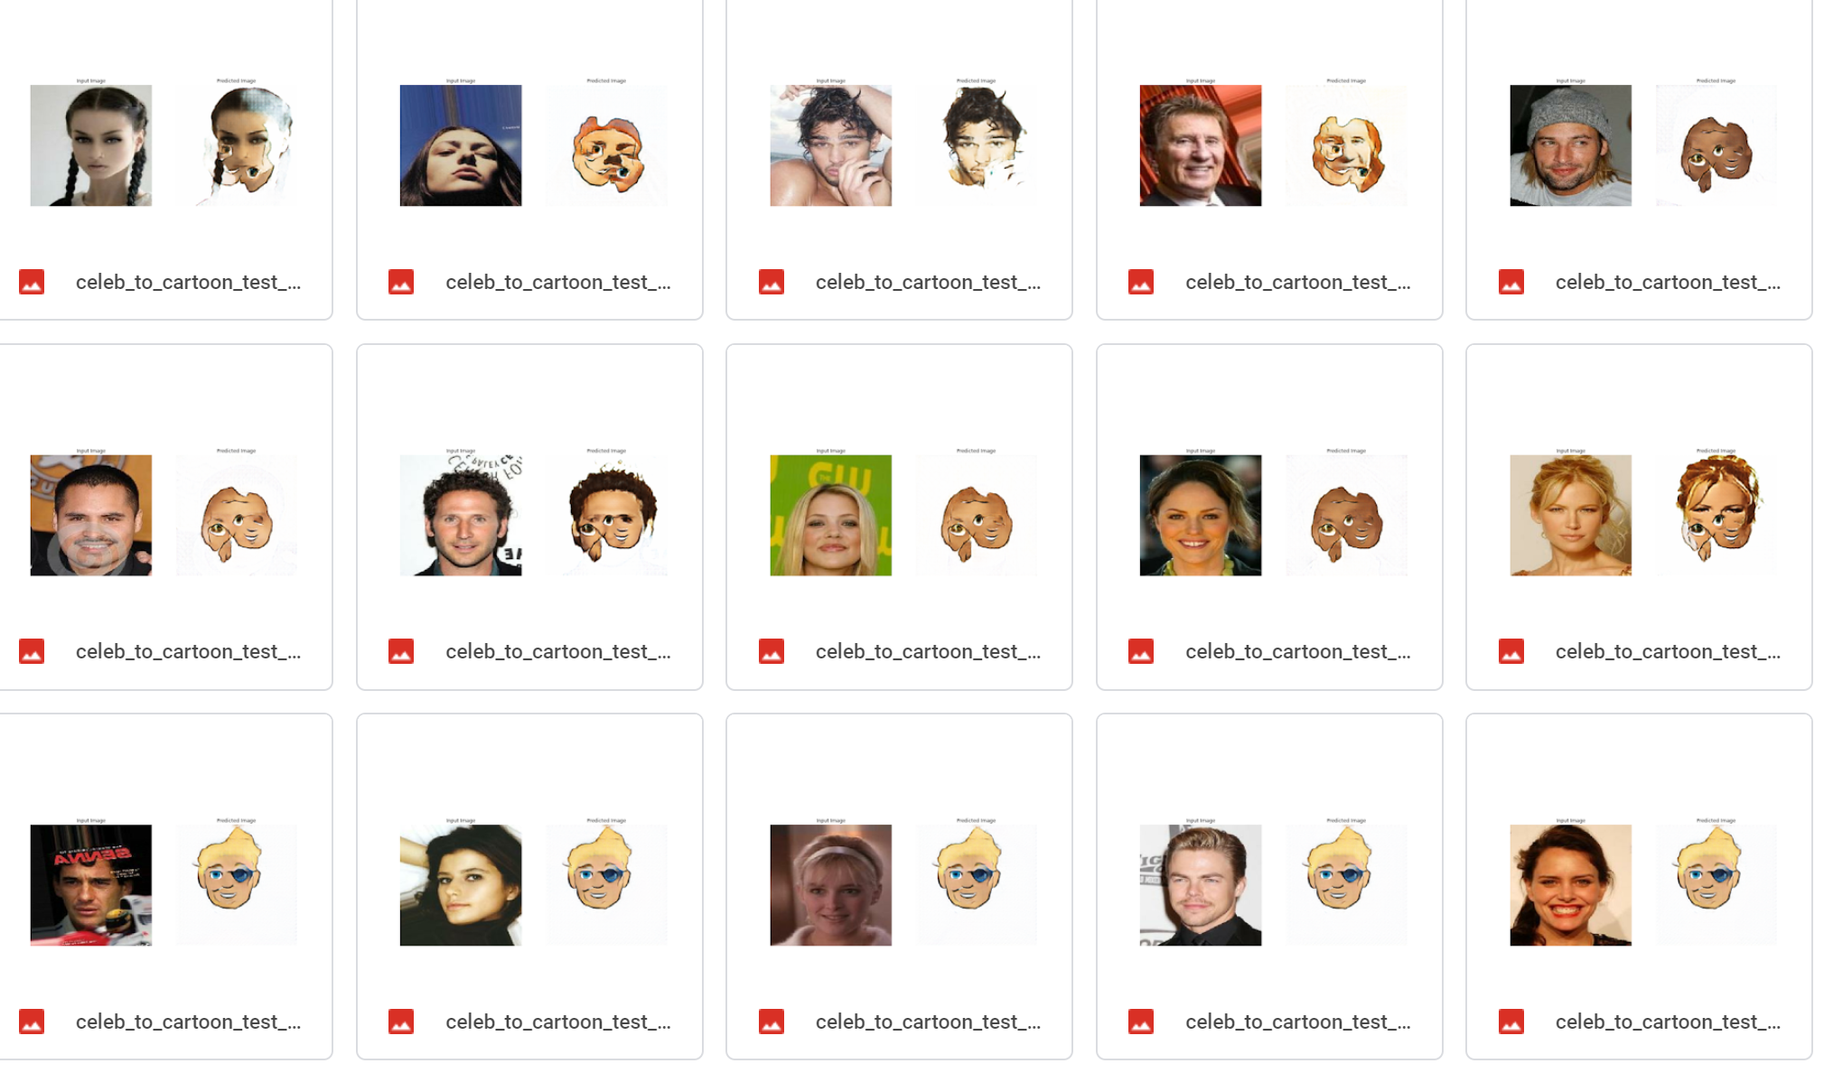
Part 4: Problems encountered - Model predictions on test set
After 5 epochs
After 14 epochs
After 100 epochs

Slide 12
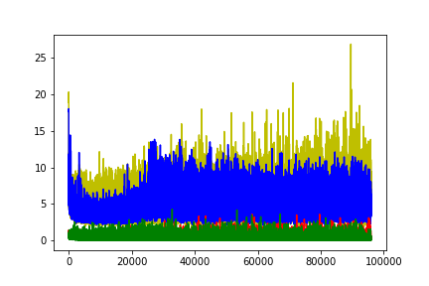
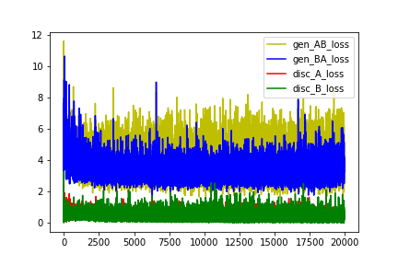
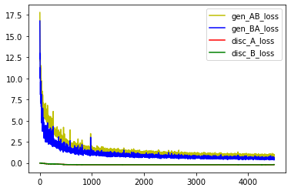
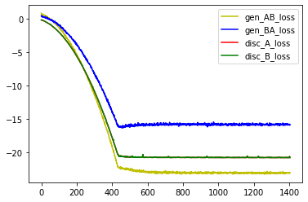
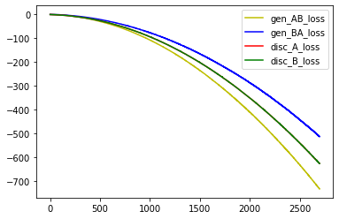
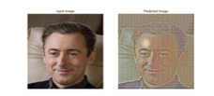
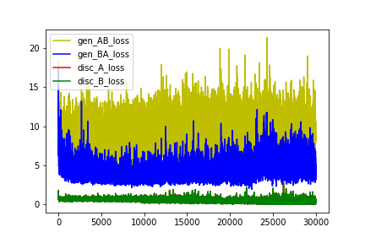
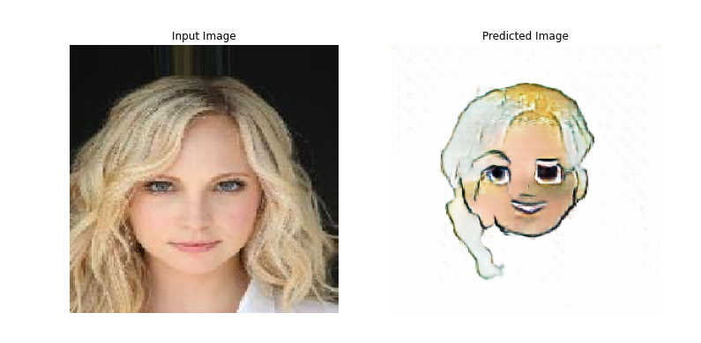
Part 4 : Parameter tuning
CycleGAN: Adam (lr=0.0004)
WGAN: rmsprop (lr=0.0002)
Clip 0.1
Clip 0.01
no clip
CycleGAN: Adam, Discriminator slower than Generator

Slide 13
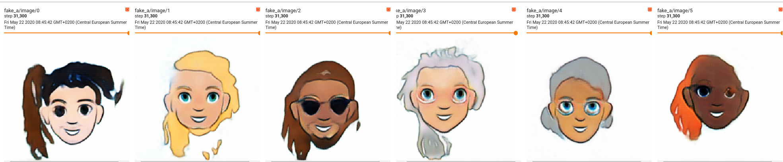
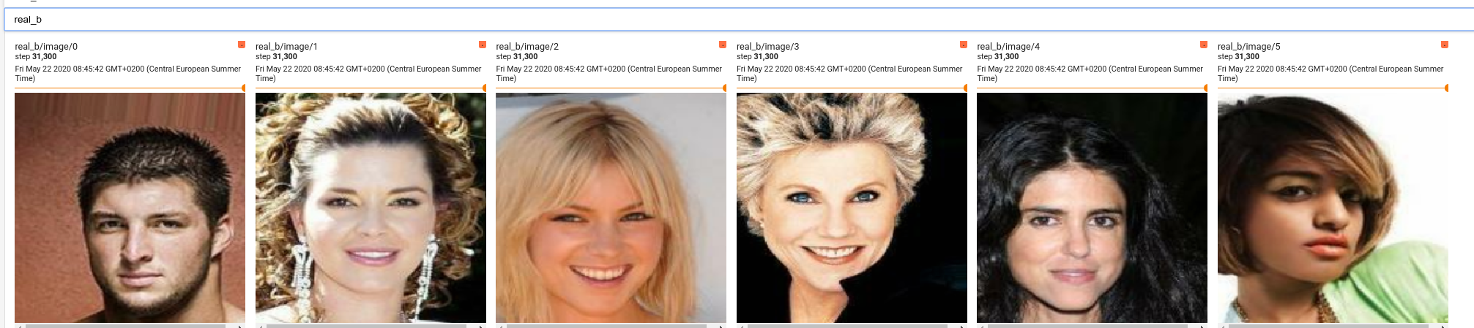
Part 5: Further Development
ResNet instead of modified Unet
WGAN-GP (Wasserstein GAN with gradient penalty)
Train on bigger dataset (10k images to total 200k iterations)
Further parameter tuning
Use a better set of cartoon images
Include landmark information on face attribute (available for both dataset however in different format)
Notes:
• Point out further work or ideas.

Slide 14
Thanks for Your Attention

Slide 15
Mode collapse
Generator finds a small number of samples that fool the discriminator --> limited set of generated images
Wasserstein loss function (WGAN) with Lipschitz Constraint:
linear activation function in the output layer of the critic model
(allow output from -∞ to +∞)
Wasserstein loss to train the critic and generator models that promote larger difference between scores for real and generated images
Wasserstein Loss(Real Images) = 1 * Average Predicted Score
Wasserstein Loss(Fake Images) = -1 * Average Predicted Score
Constrain critic model weights to a limited range after each mini batch update (e.g. [-0.01,0.01]).
Change optimizer to RMSprop
Notes:
• Point out problems encountered.
How to Implement Wasserstein Loss for Generative Adversarial Networks -> https://machinelearningmastery.com/how-to-implement-wasserstein-loss-for-generative-adversarial-networks/
The Wasserstein Generative Adversarial Network, or Wasserstein GAN, is an extension to the generative adversarial network that both improves the stability when training the model and provides a loss function that correlates with the quality of generated images.
It is an important extension to the GAN model and requires a conceptual shift away from a discriminator that predicts the probability of a generated image being “real” and toward the idea of a critic model that scores the “realness” of a given image.

Slide 16
References
https://www.tensorflow.org/tutorials/generative/cyclegan
Generative Deep Learning David Foster
Image-to-Image Translation with Conditional Adversarial Networks P.Isola
Improved Training of Wasserstein GANs I.Gulrajani
Image-to-Image Translation with Conditional-GAN Stanford University
https://machinelearningmastery.com/how-to-implement-wasserstein-loss-for-generative-adversarial-networks/
https://medium.com/@jonathan_hui/gan-why-it-is-so-hard-to-train-generative-advisory-networks-819a86b3750b
https://github.com/hiwonjoon/cycle-gan-tf
https://www.groundai.com/project/landmark-assisted-cyclegan-for-cartoon-face-generation/1

